Slide 1
Cryptography Introduction

Slide 2
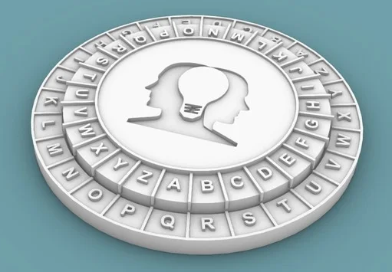
What is Cryptography?
Example of a cipher disk used to help encode and decode a Ceaser Cipher
Comes from the two Greek words kryptos and graphein
Kryptos meaning “a secret” or “to hide”
Graphein meaning “to study”
Cryptography methods have been around for thousands of years
One of the first examples is a Ceaser Cipher which would have been used in the early BC’s.

Slide 3

Cryptoanalysis
The art (or study) of solving/cracking encryptions
There are constantly people/research happening to find flaws and/or weaknesses in ciphers
No cipher is 100% secure, but how secure can we make them?

Slide 4
Cryptography Basics
Plaintext
Message to be sent (not encrypted)
Ciphertext
The message when encrypted
Cipher (also known as a Key)
The algorithm that is used to encrypt and decrypt the message
Plaintext
panda
Cipher/Key
1 letter shift
Ciphertext
qboeb
Cipher/Key
1 letter shift (back)
Plaintext
panda

Slide 5
Cryptographic Keys (Ciphers)
Keep them private
You don’t want the public knowing how to decipher your messages
The Key determines the output
Many different types of key
Some keys are one-way keys and cannot be undone
Trust the process
Sometimes the algorithm is well known
However, the public does not know the individual key

Slide 6
Key Basics
Do not use short keys
Helps prevent against brute force attacks
128-bit or higher keys are common
A lot of keys use very high prime numbers
How to exchange keys (across an unsecure medium)?
Key must remain a secret
Trusted domains help protect the keys
Diffie-Hellman is a common key exchange
Encrypt and protect the key exchange

Slide 7
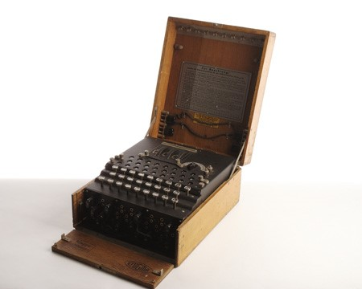
Famous Ciphers
Enigma Machine
Pigpen Cipher
Used by Freemason’s in the 1700’s
Letters represented by symbols
Enigma Machine
Used by Germans in WWII
“Cracked” by some of the Allies

